Slide 1

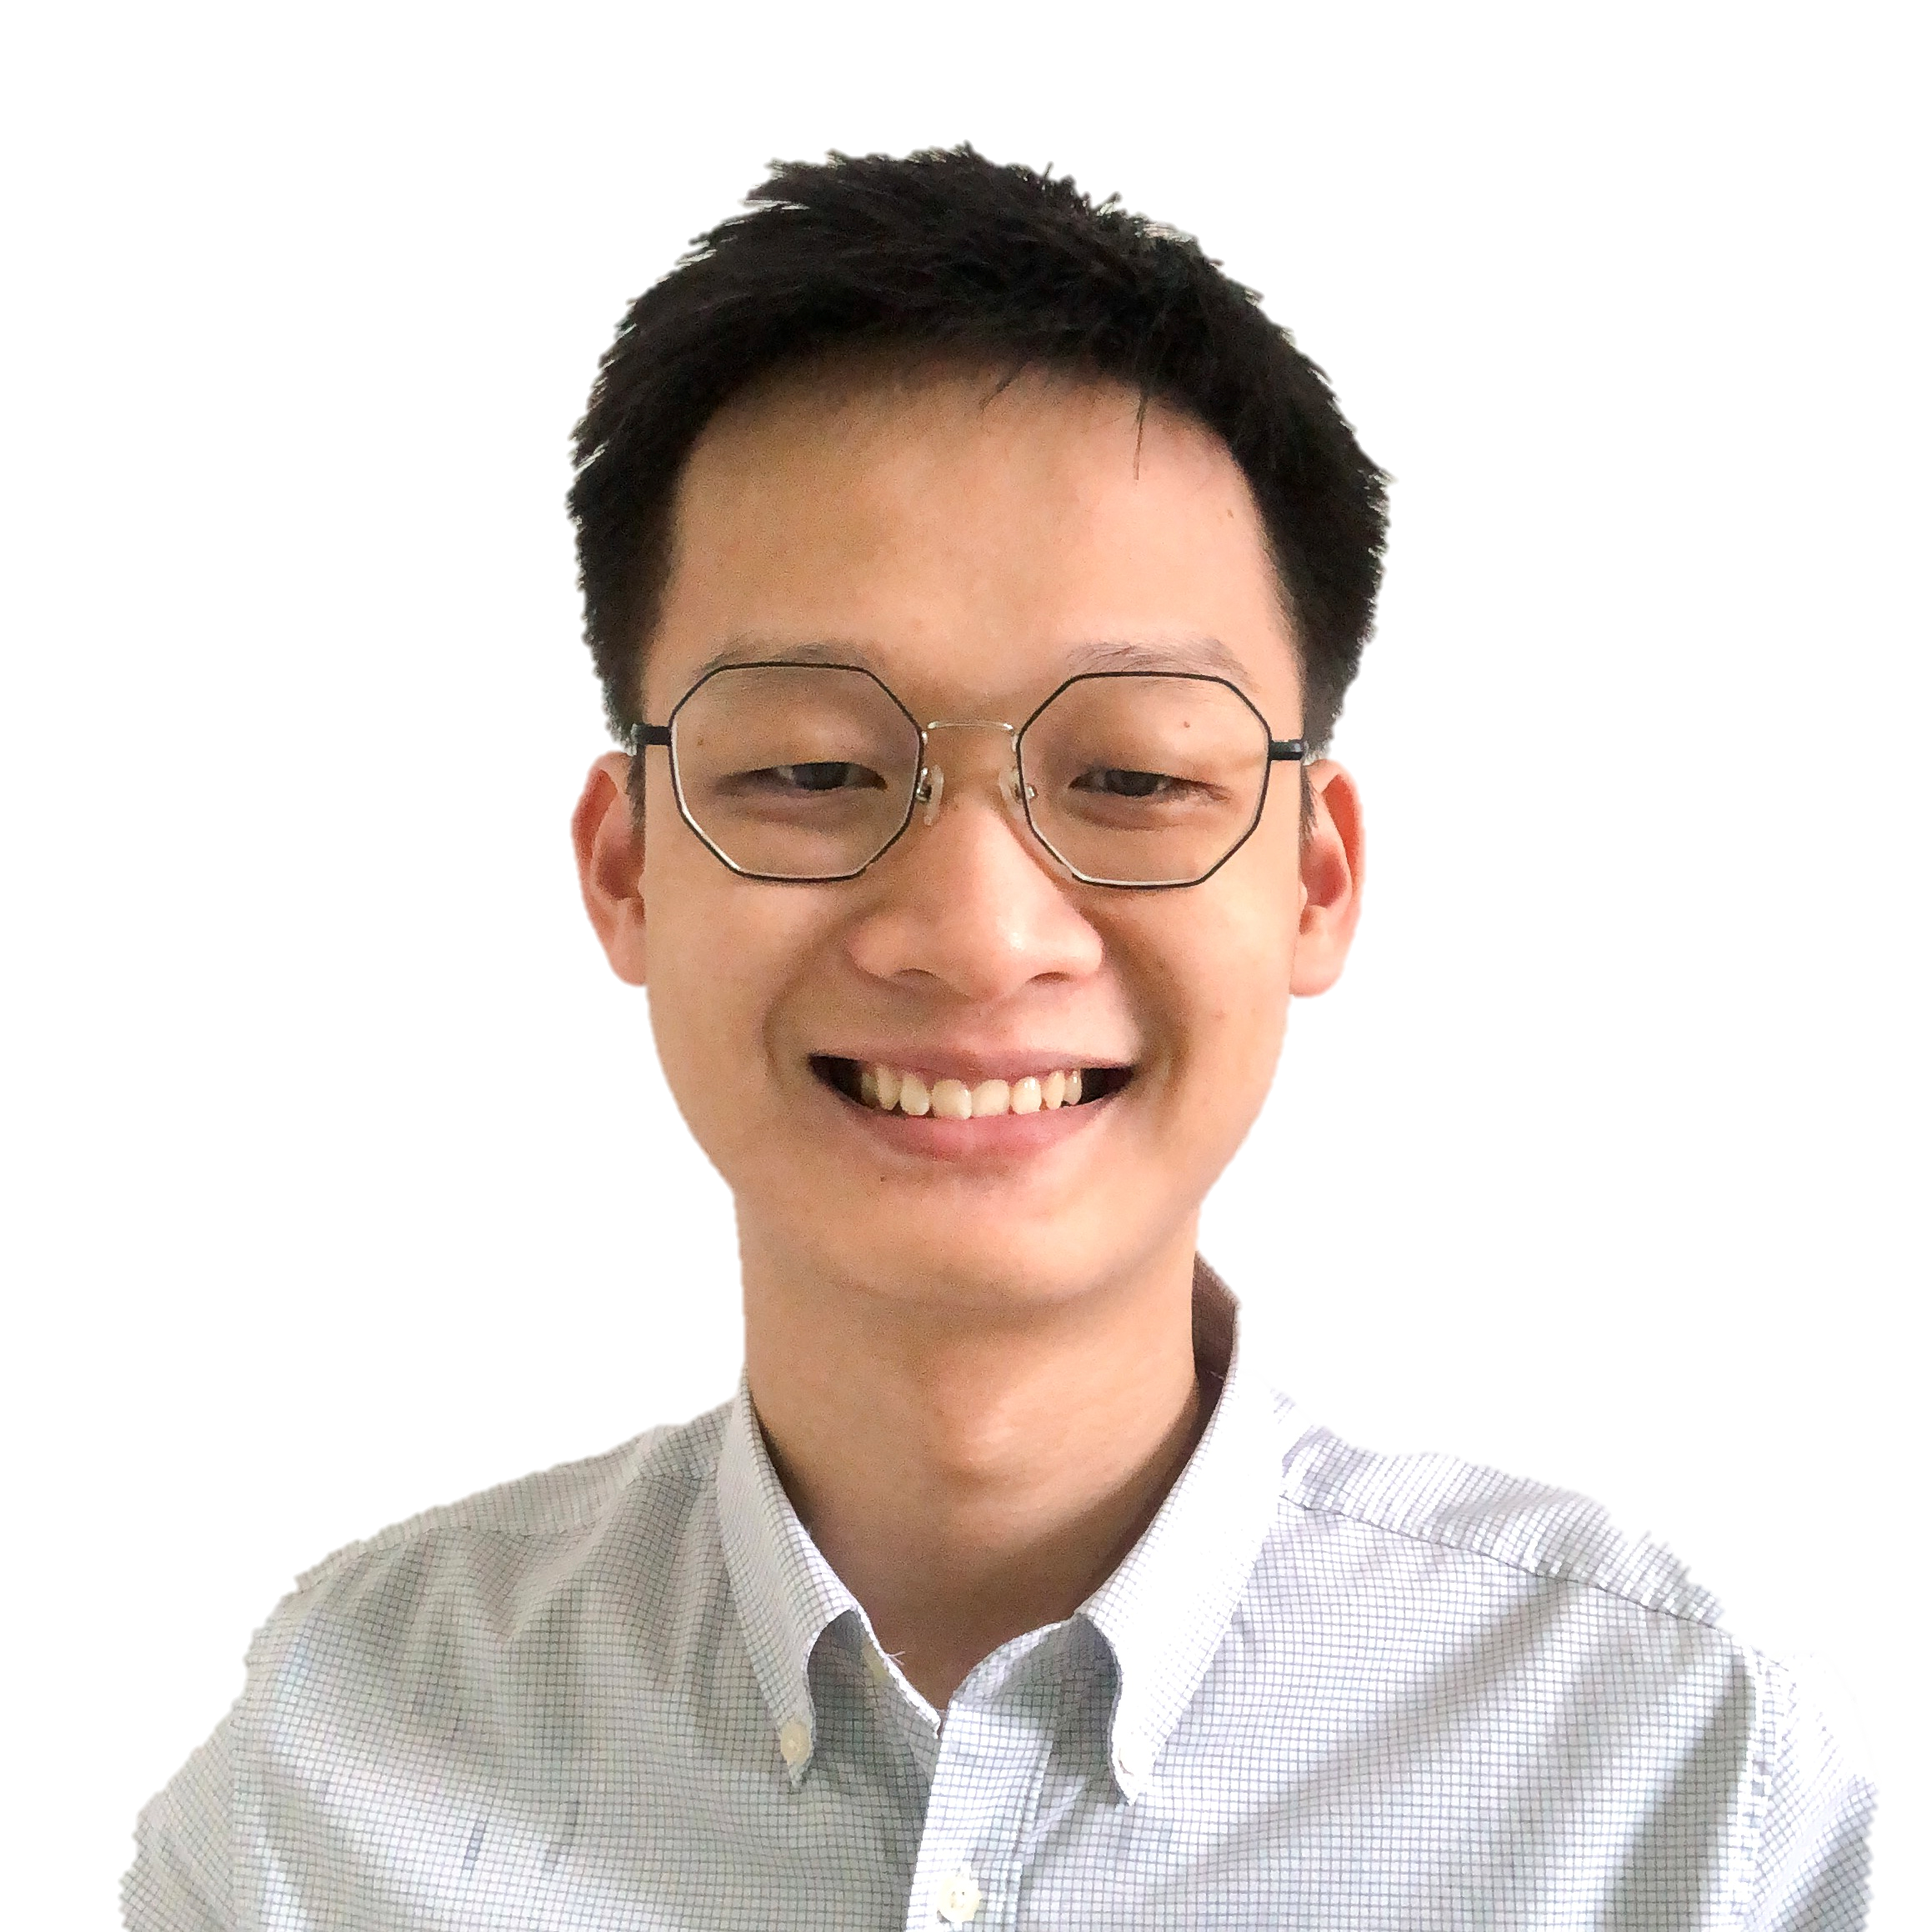
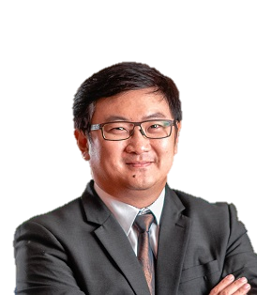
Transfer Learning using Convolutional Vision Transformers (ConViT) and Convolutional Neural Networks (CNNs) for COVID-19 Diagnosis System
Pun Liang Thon¹, Joel C. M. Than¹, Rosminah M. Kassim², Ashari Yunus³, Norliza M. Noor⁴, Patrick Then¹
¹ Faculty of Engineering, Computing and Science, Swinburne University of Technology Sarawak Campus, Jalan Simpang Tiga, Kuching 93350, Sarawak, Malaysia
² Dept of Diagnostic Imaging, Kuala Lumpur Hospital, Malaysia
³ Institute of Respiratory Medicine, Kuala Lumpur, Jalan Pahang, 50586 Kuala Lumpur, Malaysia
⁴ Razak Faculty of Technology and Informatics, UTM Kuala Lumpur Campus, Jalan Semarak, 54100 Kuala Lumpur, Malaysia
20 July 2022

Slide 2
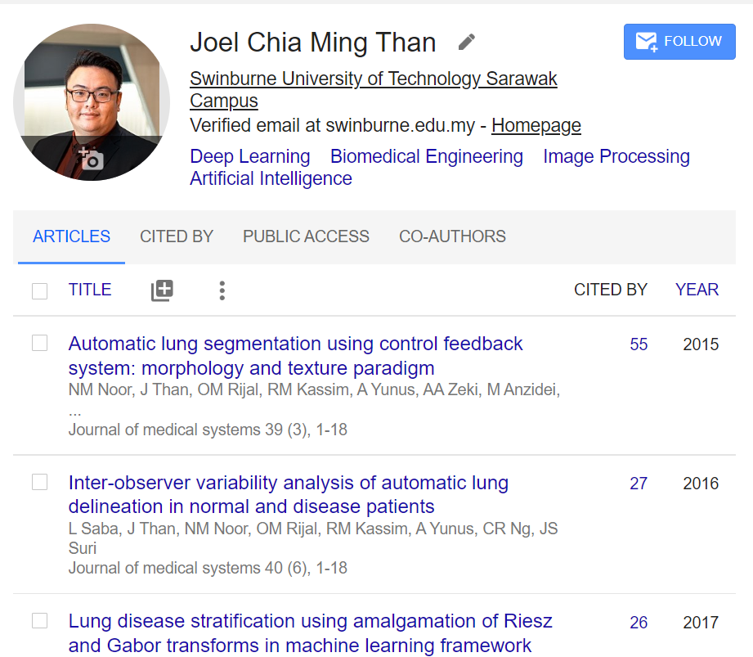
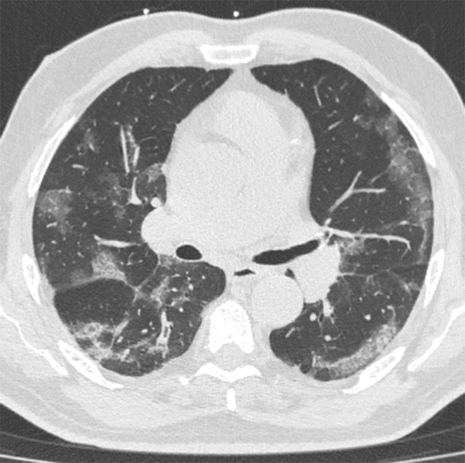



Favourite breakfast: Laksa!
PhD, Masters (UTM)
B. Eng (UTAR)
Research Interest:
Use of AI for lung disease detection
Explainable AI
Natural Language Processing
AI + Insurance
AI + Education

Slide 3
Overview
Introduction
Methodology
Dataset
CNNs – Inception V4, ResNet50, Xception, VGG16
Vision Transformers – ViT, ConViT
Performance Evaluation
Results & Discussion
Conclusion

Slide 4
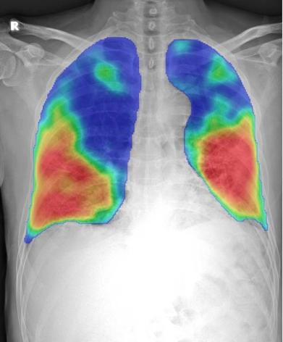
Introduction
Disease
Diagnosis Methods currently used
Deep Learning methods commonly used

Slide 5
Introduction - Diagnosis of Disease
COVID-19 third anniversary – outbreak in December 2019, in China.
Variants – Delta, Omicron etc.
RT-PCR – High sensitivity, specificity
Chest CT & CXR – Radiological findings – Deep Learning

Slide 6
Introduction – Diagnosis of Disease using Deep Learning
Convolutional Neural Networks (CNNs)
Hard inductive biases – Sample efficient learning
Vision Transformers
Simpler architecture
Hybrid – Convolutional Vision Transformer
“Soft” Inductive Biases

Slide 7
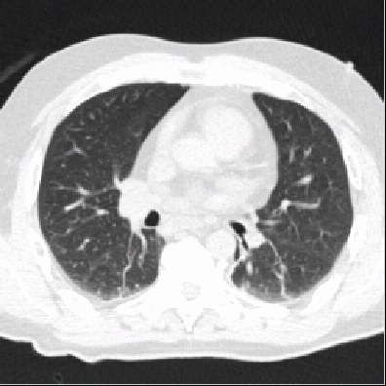
Methodology
Dataset Description
CNN
Transformers
Performance

Slide 8
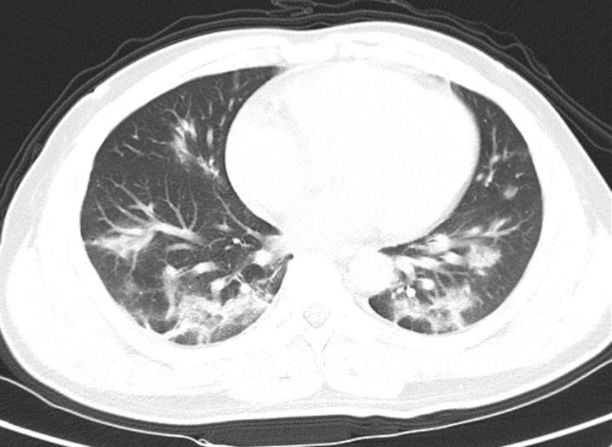
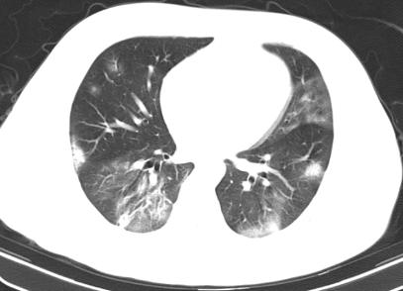
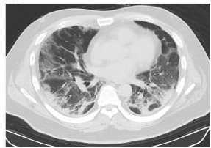
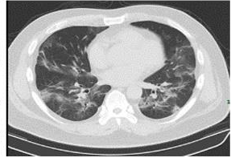
Dataset
COVID-CT-Dataset
Publicly available
349 COVID-19 CT images from 216 patients, 397 non-COVID-19 CT images.
Validated by an experienced radiologist from Tongji Hospital, Wuhan, China.
PNG format, with various height and weight pixels.
Examples of COVID-19 CT images

Slide 9
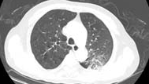
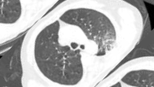
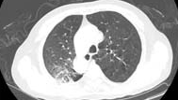
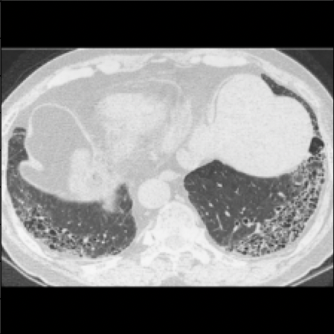
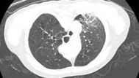
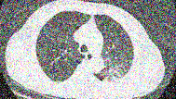
Dataset
Data Augmentation
Improves generalizability
45˚rotation
Horizontal Flip
Vertical Flip
Random Noise
Black Padding
Same height and weight
Examples of augmented COVID-19 CT images

Slide 10

Convolutional Neural Networks (CNN)
Convolutional Layer
Extract low-level features, e.g., edges, as increase more layers, extract high-level features.
Pooling Layer
Reducing the spatial size
Decrease the computational power required
Extract dominant features
Fully Connected (FC) Layer
Learning non-linear combinations of high-level features

Slide 11
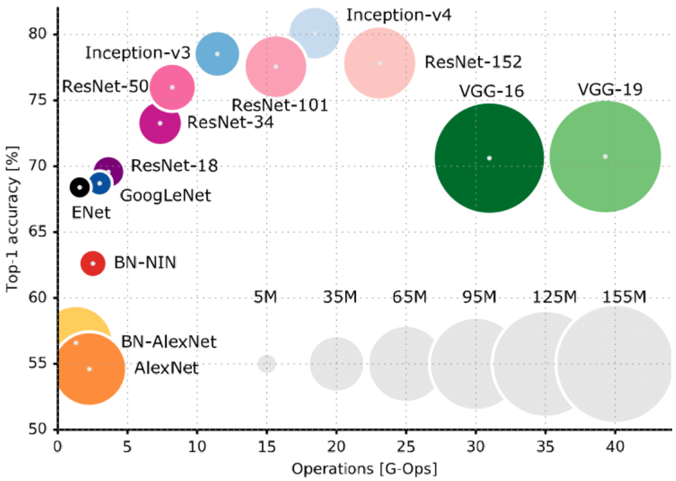
Convolutional Neural Networks (CNN)
CNNs used in this study:
Inception V4
ResNet50
Xception
VGG16
Convolutional architectures proven success for vision tasks.
Hard inductive biases enable simple efficient learning, at a cost of lower performance ceiling.

Slide 12
Vision Transformer (ViT)
Introduced by Dosovitskiy et. al. 2020
Images can be used in patches sized at 16 x 16 pixels to extract information that are passed to a transformer.
The input patches is first projected linearly to produce a 1D sequence of vectors.
Then combined with position embedding.
The combination is then passed to transformer encoder.
ViT performance suffers when data is scarce.
Lack of well-informed inductive biases that are usually presented in CNN methods.
The need of hybrids of convolutional and transformers to tackle smaller dataset problem.

Slide 13
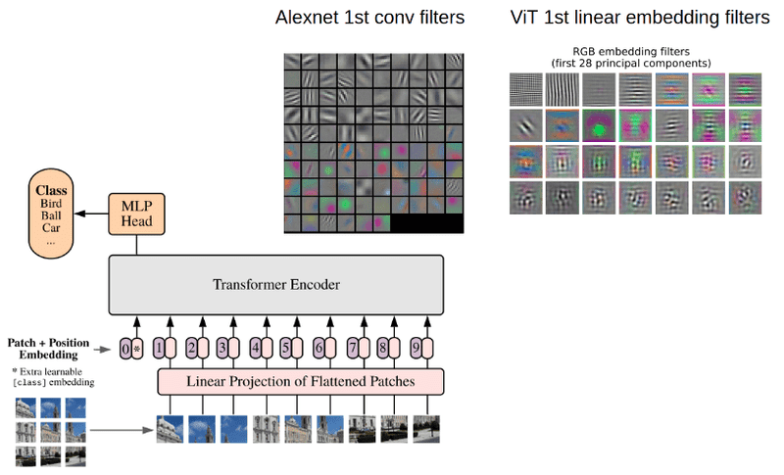
Vision Transformer (ViT) compared with Alexnet

Slide 14
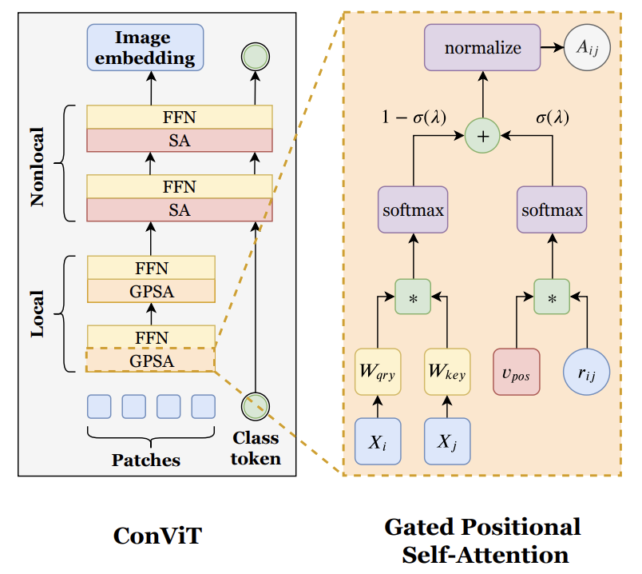
Convolutional Vision Transformer (ConViT)
Introduced by d’Ascoli et. al. 2021
Introduce gated positional self-attention (GPSA)
equip “soft” convolutional inductive bias into the ViT.
mimic the locality of convolutional layers, then give each attention head the freedom to escape locality by adjusting a gating parameter regulating the attention paid to position versus content information

Slide 15
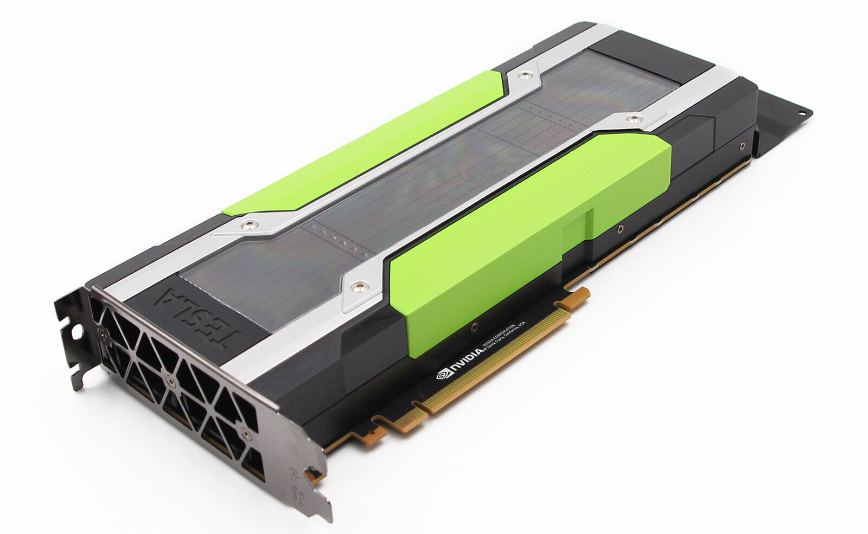
Performance Evaluation
Accuracy,
Sensitivity,
Specificity,
Negative Predictive Value (NPV),
Positive Predictive Value (PPV),
F1-Score
Transfer Learning
80% Training 20% Test
Google Colab: Tesla P100 GPU

Slide 16
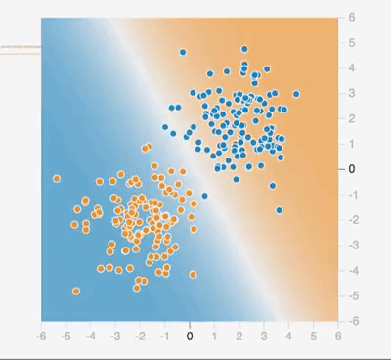
Results
Comparison of Networks
Comparison with SOTA
Comparison of Time

Slide 17
Performance: CNNs & Vision Transformers
Accuracy, Sensitivity, Specificity, Negative Predictive Value (NPV), Positive Predictive Value (PPV), F1-Score
Transfer Learning
Google Colab: Tesla P100 GPU
Model | Accuracy | Sensitivity | Specificity | PPV | NPV | F1-Score
ResNet50 | 0.880 | 0.846 | 0.910 | 0.892 | 0.870 | 0.868
Inception V4 | 0.928 | 0.886 | 0.965 | 0.957 | 0.906 | 0.920
Xception | 0.914 | 0.914 | 0.915 | 0.904 | 0.924 | 0.909
VGG16 with BN | 0.952 | 0.926 | 0.975 | 0.970 | 0.937 | 0.947
ViT-S | 0.968 | 0.960 | 0.975 | 0.971 | 0.965 | 0.966
ConViT-S | 0.979 | 0.971 | 0.985 | 0.983 | 0.975 | 0.977

Slide 18
Training Duration: CNNs & Vision Transformers
Model | Training Duration
ResNet50 | 14m 13s
Inception V4 | 20m 20s
Xception | 16m 53s
VGG16 with BN | 18m 31s
ViT-S | 14m 9s
ConViT-S | 20m 13s
* Trained on Tesla P100 GPU

Slide 19
Performance comparison with other SOTA networks using the same dataset.
Study | Overall Accuracy
ResNet50 with Wavelet Coefficients ¹ | 0.922
DenseNet-169 with Self-Trans method ² | 0.86
DenseNet-210 (Custom Input Size) ³ | 0.929
This Study (ConViT-S)* | 0.979
Matsuyama, E.: A Deep Learning Interpretable Model for Novel Coronavirus Disease (COVID-19) Screening with Chest CT Images. J. Biomed. Sci. Eng. 13, 140–152 (2020).
He, X., Yang, X., Zhang, S., Zhao, J., Zhang, Y., Xing, E., Xie, P.: Sample-efficient deep learning for COVID-19 diagnosis based on CT scans. IEEE Trans. Med. Imaging. XX, (2020).
Alshazly, H., Linse, C., Barth, E., Martinetz, T.: Explainable COVID-19 Detection Using Chest CT Scans and Deep Learning. Sensors. 21, 455 (2021).

Slide 20
Conclusion & Future Works
ConViT-S achieved the best performance.
ViT-S used the shortest duration to complete training.
Vision Transformers show promising future as compared to CNNs.
Lung Disease Severity Classification
Hyperparameters tuning
Explainable Artificial Intelligence (XAI)

Slide 21
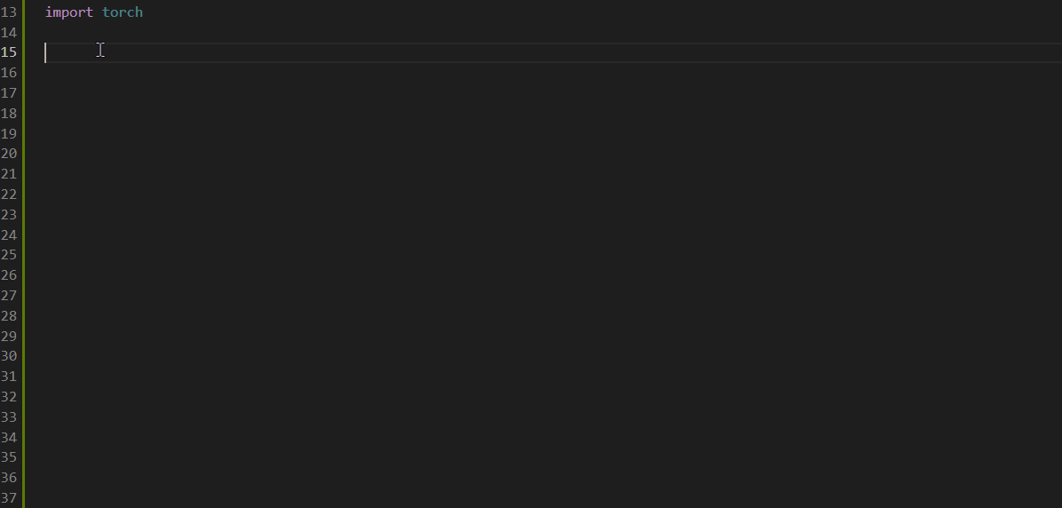
Thank you
Contact Information:
Dr Joel Than Chia Ming
Email: jcmthan@swinburne.edu.my
Profile: https://www.swinburne.edu.my/staff/dr-joel-than-chia-ming.php
Linkedin: https://www.linkedin.com/in/joel-than-b7969480

